Slide 1
AI CRASH DETECTION SOFTWARE
Presented By,
TEAM 4

Slide 2
TEAM MEMBERS
1. SAHAL SALAM K A
2. SALIH P ASHRAF
3. GEORGE JOSEPH
4. MOHAMMED AMEEN

Slide 3
Project Overview
Cutting-edge crash detection AI system
Enhanced accuracy and responsiveness
Multi-platform compatibility (PC & Mobile)
Real-time crash detection & emergency response

Slide 4
SYSTEM DESIGN DETAILS
Development Tools & Technologies
IDE:
  PyCharm for PC application
  Android Studio for mobile app development
Languages:
  Python for PC-based application
  Dart (Flutter framework) for mobile application
  Java for Android-specific implementations
Backend Infrastrcture:
  Firebase for database management, real-time synchronization, and app hosting
  Firebase Cloud Messaging (FCM) for notifications
Frontend:
  Tkinter or CustomTkinter for PC GUI
  Flutter for mobile app interface

Slide 5
AI FRAMEWORKS & LIBRARIES
AI Model Development
Ultralytics YOLOv8:
  State-of-the-art object detection model
  Optimized for crash detection scenarios
Torch & Torchvision:
  Core PyTorch framework used for training and deployment
OpenCV-python-headless:
  Efficient library for real-time image and video stream processing
Dataset:
  Over 8,600 labelled images and videos for robust crash event detection
  Diverse scenarios to enhance model generalization

Slide 6
KEY FEATURES
System Features
Real-Time Crash Detection:
  Processes video feeds to identify crash events immediately
  High accuracy with minimal false positives and negatives
Automated Notifications:
  Sends alerts to emergency responders via Firebase Cloud Messaging
  Ensures timely action in critical situations
Cross-Platform Integration:
  Synchronization between PC and mobile applications
  Unified data and seamless monitoring experience
Image & Video Processing:
  Handles high-resolution streams efficiently using OpenCV
Performance Analytics:
  Tracks detection accuracy, system responsiveness, and user engagement
  Provides insights for continuous optimization

Slide 7
ADVANTAGES
System Advantages
Efficiency: Real-time operation minimizes delays in emergency response
Scalability: Supports expanding datasets and system complexity
Accuracy: Advanced AI models reduce false positives and negatives
Cost-Effective: Cloud-based infrastructure reduces hardware costs
Data Security: Implements robust Firebase security protocols for data privacy
User-Friendly: Intuitive design ensures ease of use for both administrators and end-users

Slide 8
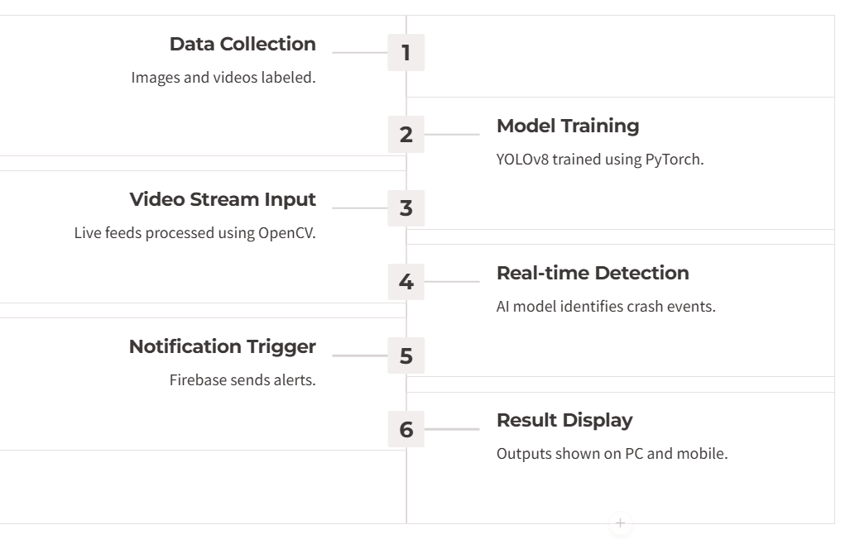
WORKFLOW DIAGRAM

Slide 9
IMPLEMENTATION DETAILS
Development:
  Setting up IDEs (PyCharm, Android Studio) and Flutter environment
  Training AI models using YOLOv8
  Backend integration with Firebase
Testing:
  Extensive testing with diverse crash scenarios
  Performance evaluation and debugging
Deployment:
  Deployment on PC and mobile platforms
  Final validation in real-world environments

Slide 10
LIMITATIONS
Limited Coverage : CCTV cameras often cover specific areas, leaving blind spots where accidents may go undetected.
Low Image Quality : Poor resolution, especially in older CCTV systems, can hinder accurate detection of crashes or other events.
Environmental Constraints : Weather conditions such as rain, fog, or poor lighting can reduce the effectiveness of video footage for crash detection.
False Alarms : Movements like falling objects, shadows, or animals can lead to misinterpretation of events without advanced filtering mechanisms.

Slide 11
CONCLUSION
Conclusion
Revolutionizing crash detection with AI-driven solutions
Enhanced real-time responsiveness and multi-platform usability
Scalable system ready for future advancements
Aimed at improving emergency response efficiency and saving lives

Slide 12
THANK YOU

